Slide 1

MIRPUR UNIVERSITY OF SCIENCE AND TECHNOLOGY (MUST), MIRPUR DEPARMENT OF COMPUTER SCIENCE & INFORMATION TECHNOLOGY

Slide 2
Professional Practices BIT-4802 Lecture [1] : Introduction
Dr. Samina Khalid
(Assistant Professor)
Date: April 23, 2020

Slide 3

COURSE DESCRIPTION
A foundational course in computer science that is:
Designed to familiarize students with professional practices in computer science, and to enable them to:
Identify ethical conflicts,
Identify their responsibilities and options, and
Think through the implications of possible solutions to ethical conflicts.

Slide 4
COURSE OBJECTIVES
Objective of this course are following:
To make students aware of themselves as members of a profession, with shared community principles.
To make students aware of the ethical implications of their professional choices, and of the communities (employer, customers, society at large) whose interests they serve.
To make students aware of how they apply ethical principles to resolve situations that arise in their professional lives.
To make students aware of professional organizations that can help them deal with professional issues.

Slide 5
COURSE SCHEDULE
Till Mid Term
Topic 1: Introduction to Ethics, Philosophies, regarding to Ethics and morals
Topic 2: Introduction to Computer and Cyber Ethics
Topic 3: Computer Ethics history. Sample Case Studies
Topic 4: Ten Commandments
Topic 5: Sample topics to study in this subject
Topics 6: Types of Ethics, Relationship of different types of ethics
Topic 7: Essential components of personal ethics, ACM code of conduct

Slide 6
COURSE SCHEDULE
After Mid Term
Topic 8: Definition of Cyber crime, general types of cyber crime, cyber crime statics
Topic 9: Types of Cyber crime technically specified by Australian institute of criminology
Topic 10: Management Hierarchy, IT organization structure, staff management, five golden rules of staff management
Topic 11: Definition of team, team management, four C’s of team management,
Topic 12: Elements of healthy teams, way to inspire and motivate team, ethical issues in team management.
Topics 13: Character of high performance teams

Slide 7
COURSE TEXTBOOKS
Book 1:
Bott, Frank, Allison Coleman, and Diane Rowland. Professional issues in software engineering. CRC Press, 2000.
Deborah G. Johnson, “Computer Ethics”, Pearson Education (2001) 3rd edition.

Slide 8
GRADING POLICY
Mid Term: [30%]
Quizzes: [5%]
Assignments: [5%]
Semester Project: [10%]
Final Exam: [50%]

Slide 9
HOMEWORK & ASSIGNMENT POLICY
Assignments:
Each student needs to submit two assignments, on before midterm and one after midterm examinations in hard form and also in soft form with plagiarism not more than 15% (references must be included at the end of each assignment).
Assignment must need to upload on turnitin class for plagiarism checking. Otherwise hard form will not be acceptable.
Front page of assignment must be properly formatted with following information:
Assignment title, Assignment No., Student Name, Student Roll no (properly formatted according to CMS), Session, Subject Name, Subject Code, Plagiarism (%), Submission date, and Instructor Name.
Late submission of assignments will not be entertained.
Plagiarised Assignment will be marked zero
Quizzes:
There will be unannounced quizzes randomly (before start of lecture / after lecture) and one announced quiz before midterm and terminal examination.
If any student would not be able to attend quiz, quiz will not be taken again.
All assignments and quizzes will be considered for grading

Slide 10
Professional Practices
Overview of computer Ethics

Slide 11
Today’s Agenda
Historical, Social, and Economic context of Computing
Computer Science
Software Engineering
Information Technology

Slide 12
Historical Perspective
One of the most silent concerns;
Computer threatened our notion(concept) of what it means to be human because
Computer can do anything that was considered unique to be humans, rational (logical, intelligent) thinking. E.g. Artificial Intelligence…….
So, There was some fear might computer take over decision making from humans. E.g. 2001 movie, “Are there decisions that computer should never make” by jim moor in 1979.?

Slide 13
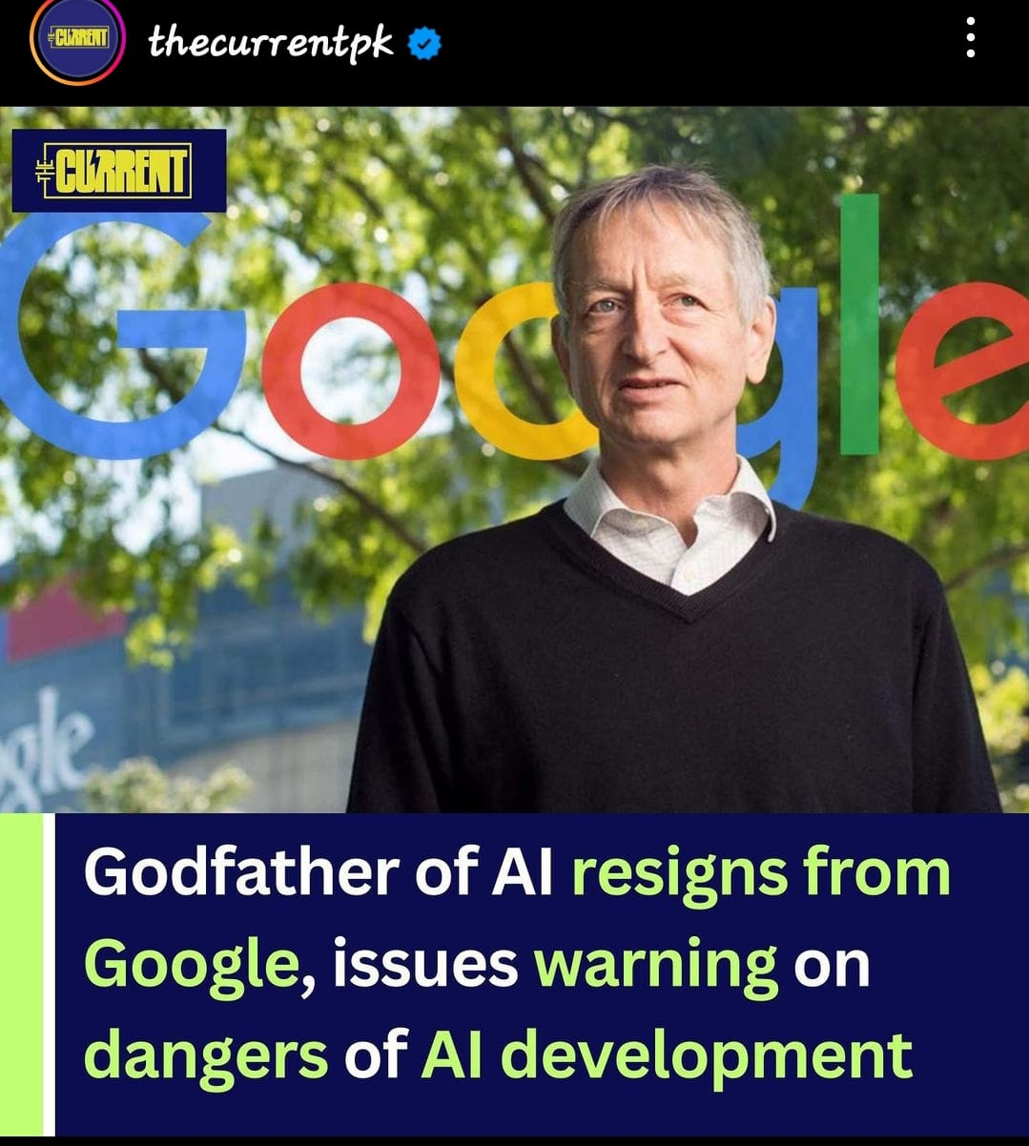

Slide 14
Historical Perspective
In early age of computer, concerns about computers were not exactly ethical in character.
E.g. No one explicitly argued that its immoral to go forward with the development of computers because of its threat to our concept of human beings. Neither its immoral to turn over decisions making power to computer.
Rather, the implicit argued that there would be terrible consequences e.g. possible disasters and degradation of human life. Where decision making turned to over to computers.

Slide 15
Historical Perspective
These concerns did not come from the use of computers; they arose from simple ideas of computers ?
There very idea of a technology that could think or do something very close to it was threatening to our understanding of what it means to be human.
Computer can think like humans-→ Cognitive science and other disciplines (see Bynum and Moor, 1999)

Slide 16
Historical Perspective
In late 1970s, the ethical issues began to be more clearly articulated in the works of Joseph weizenbaum (1979) and Abbe Mowshowvitz (1976).
When Privacy Protection Commission did a major study of Privacy.?
In those days computers were used in big governments and large scale organizations for maintaining their databases (especially personal information databases).
Computers are being used for large numerical calculations primarily for government activities such as weapons development, space travel, etc

Slide 17
Historical Perspective
The next major technological shift was development of small computers.
Remote access had come on scene, first as access on mainframes, later as web of telecommunications connections between small computers.
Attention turned to software's and ethical issues surrounding it.
Computer technology become visible and powerful into the consumer market place.
Software's were recognized as something with giant market values, and hence, all the ethics issues having to do with property arose.

Slide 18
Should Software Be Owned?
If so how?
Would current intellectual property law provide adequate protection?
Along with property rights issues came issues of liability and responsibility.
In market place, when consumer buy and use computers and software, they want to rely on these tools and when something goes wrong, they want to know who to blame or they want to be compensated for their losses.

Slide 19
Should Software Be Owned?
During this period, attention began to focus on computer hackers.
They did not like the idea of property rights in software.
At the same time, those who acquiring property rights and or making a business of computing saw the threat posted by hackers, a threat to property rights and to system security.

Slide 20
Technology Shift 1990’s
Attention turned to the internet;
The coming together of computers, telecommunication, and media was the next major shift to the technological development.
Expanded use of internet brought a seemingly endless set of ethical issues as the internet came to be used in so many different ways in so many different domains of life.
During 1980’s and 1990’s one other technological development that grew slowly was the use of computer in wide variety of visualizations activities;
Computer graphics and gaming, simulation activities in medical imaging and scientific models→ this gave raise to the idea of virtual reality.

Slide 21
Internet Raised All Past Concerns
Privacy issues are compromised on the internet;
The democracy issues came back into play with a new claims about the internet’s democratic (independent) character;
Privacy rights expanded to web sites and global property rights become ever more important and so on.
Very slowly and quietly, ethical concerns have been raised about this thrust of computer technology

Slide 22
Summary
During 1960 and 1970s the dominant uses of technology were for database creation and large scale calculations.
Give raise of centralization of power and big government and threats to personal privacy.
During 1980s micro computers were developed and made readily available, remote access to large mainframe computers also become possible.
The telecommunications lines linking to computers that later become internet.
All these concerns give raise concerns about property rights, liabilities issues, and threats posted by hackers. As well as gave raise to seemingly endless array of ethical issues.

Slide 23
Reading Assignment
To learn more about computer ethics just read case studies given in preface of book as overview of book chapters.
Why computer ethics.
Philosophical ethics
Professional ethics
Ethics and internet; online ethics
Privacy
Property
Accountability
Social implications and social values

Slide 24
Reading Assignment
To learn more about computer ethics just read the top 10 technology and ethical stories of 2023:
https://www.computerweekly.com/news/366563404/Top-10-technology-and-ethics-stories-of-2023

Slide 25
Acknowledgments
GOOGLE BOOKS LINK
Deborah G. Johnson, “Computer Ethics”, Pearson Education (2001) 3rd edition.
Skelton, S.K. (2023) Top 10 technology and Ethics Stories of 2023: Computer Weekly, ComputerWeekly.com. Available at: https://www.computerweekly.com/news/366563404/Top-10-technology-and-ethics-stories-of-2023 (Accessed: 22 April 2024).

Slide 26
THANKS

